Slide 1

Program Verification Using
Aseem Rastogi
Microsoft Research
Winter School in Software Engineering 2017

Slide 2
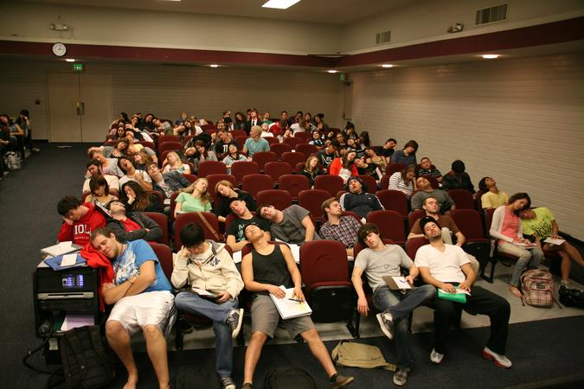
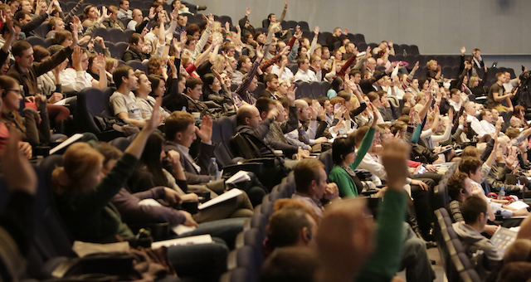
One Request Please Ask Questions!!

Slide 3


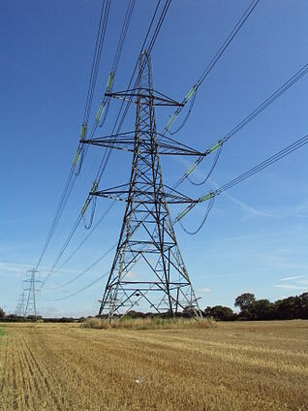



Software is Everywhere

Slide 4
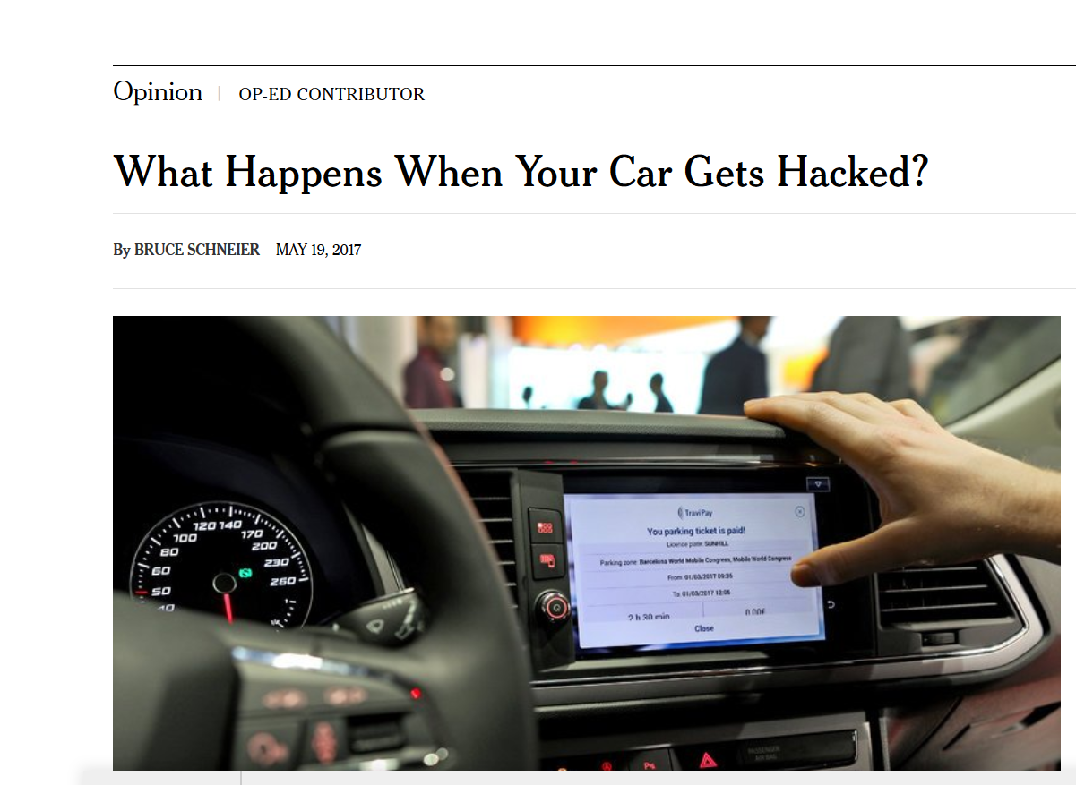
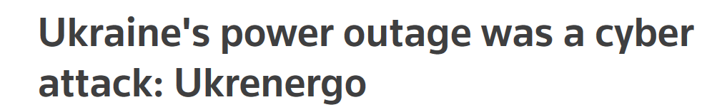
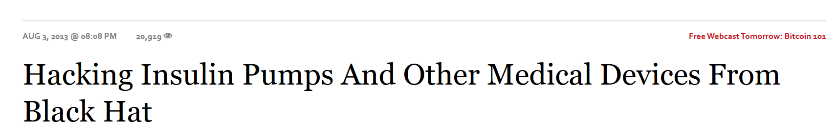

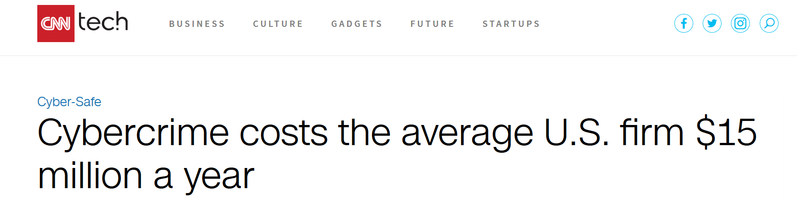
Cost of Software Bugs is High

Slide 5
Cost of Software Bugs is High
We need more reliable and secure software

Slide 6
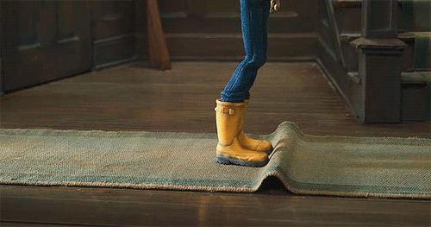
Assuring Software Quality Today Software Testing

Slide 7
Program Verification Correct-by-construction Software
Use a program verifier, proof assistant, theorem prover for dev.
Formally prove properties of the program during development
(spec: sort returns a sorted list)
let sort l = …

Slide 8

Development Process
Program
Extract code to a language such as OCaml or C
Compile to executable
Formally prove that the program meets the specifications
(F*/Dafny/Coq)
Specs
Also within the tool
Prove absence of bugs rather than that the program runs successfully on certain inputs

Slide 9
Success Stories of Program Verification
The CompCert C compiler
Formally verified C compiler written in Coq
Operating system kernels
Verve (Boogie), seL4 (Isabelle), CertiKOS (Coq)
Software stack
IronClad (Dafny)
(Mathematical proofs such as the proof of the 4-color theorem)

Slide 10
Congrats, But Does It Help?
Finding and Understanding Bugs in C Compilers
Yang et al. PLDI’11
Wrong-code errors in GCC: 79, LLVM: 202, CompCert: …
IronClad Apps: End-to-End Security via Automated Full-System Verification
Hawblitzel et al. Usenix Security’14
“Almost all the code ran correctly the first time we tried!”**

Slide 11
Very Cool! Tell Me More! This Tutorial
25-75 split between theory and practice
Theory: Hoare logic, weakest preconditions
Practice: Prove correctness of mergesort in F*
It is very important that you have a working F* installation (including the emacs plugin)
If not, shout now!
Program
Formally prove that the program meets the specifications
Specs

Slide 12

What is F* http://www.fstar-lang.org
A framework for verifying functional programs
Effectful functional programs (we will cover very little of the effectful parts though)
Advanced type system
Specifications are written in the types
Semi-automated
Uses an SMT solver at the backend to discharge proof obligation
Extracts to OCaml†
https://github.com/FStarLang/FStar

Slide 13
F* Team Microsoft Research, INRIA Paris, MIT, Univ. of Edinburgh, …
(A non-exhaustive list of people)
Danel Ahman Benjamin Beurdouche Karthikeyan Bhargavan Antoine Delignat-Lavaud Victor Dumitrescu Cédric Fournet Cătălin Hriţcu Markulf Kohlweiss Qunyan Magnus Kenji Maillard | Asher Manning Guido Martínez Zoe Paraskevopoulou Clément Pit-Claudel Jonathan Protzenko Tahina Ramananandro Aseem Rastogi Nikhil Swamy Christoph M. Wintersteiger Santiago Zanella-Béguelin

Slide 14
A First Taste Factorial program
let rec factorial n =
if n = 0 then 1
else n * factorial (n – 1)
What have we verified:
-- The function has no side effects
-- The function always terminates
-- The function always returns a natural number
val factorial: nat -> nat
$ fstar.exe Test.fst
Verified module: Test (546 milliseconds)
All verification conditions discharged successfully

Slide 15
Behind the Scenes
F* builds a Verification Condition for the program
And passes the VC to Z3 to check for validity
If Z3 succeeds, then the program meets the spec
Guaranteed by the proven (not mechanized) metatheory of F*

Slide 16
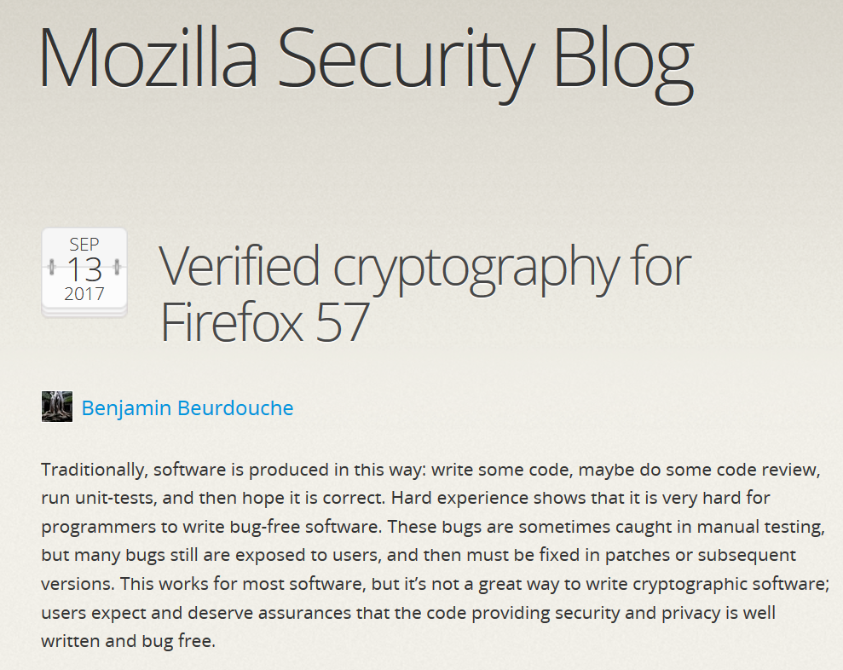
Applications of F* The F* compiler is written in F*!
Everest Project (https://project-everest.github.io/)
Aims to build and deploy a verified HTTPS stack
Ongoing effort
Verified Cryptographic Libraries
Shipping as part of Firefox 57
Wys*: Verified DSL for Secure Multi-party Computation
As a proof assistant: for several calculi, including a fragment of F*

